Slide 1
Battleship game
Jed Mijares
Jacob Culler

Slide 2
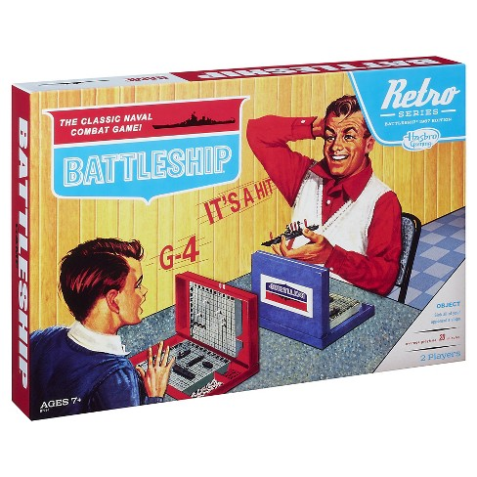
Introduction / Project Description
We are making a handheld game that lets you play the board game battleship

Slide 3
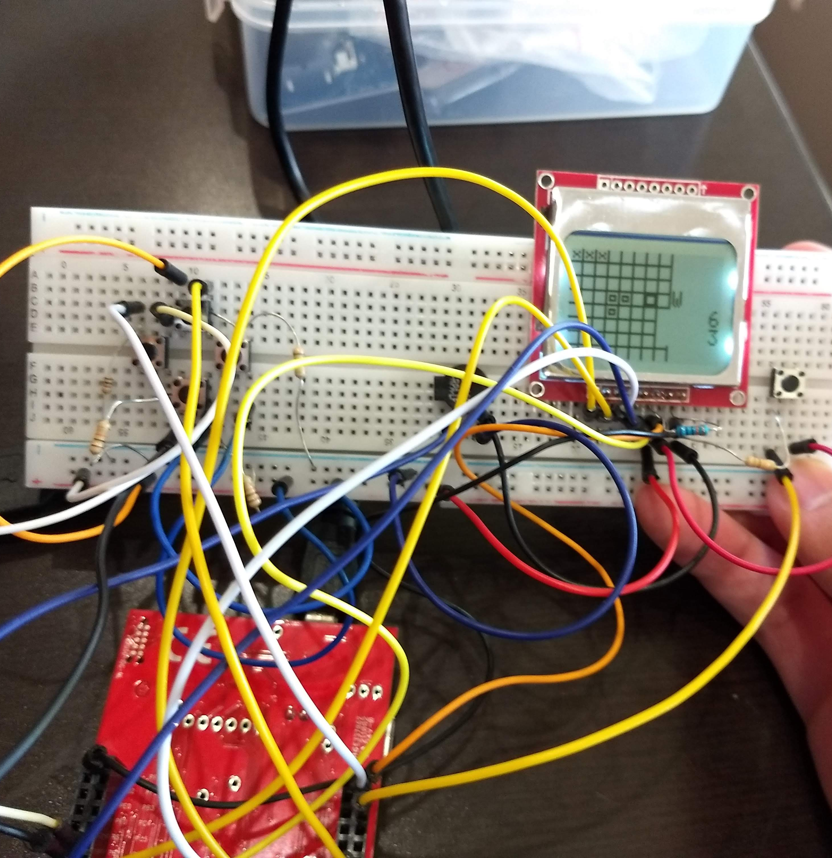
Current Progress
LCD Communication
Button Integration
Sound Output
Basic Game Logic

Slide 4
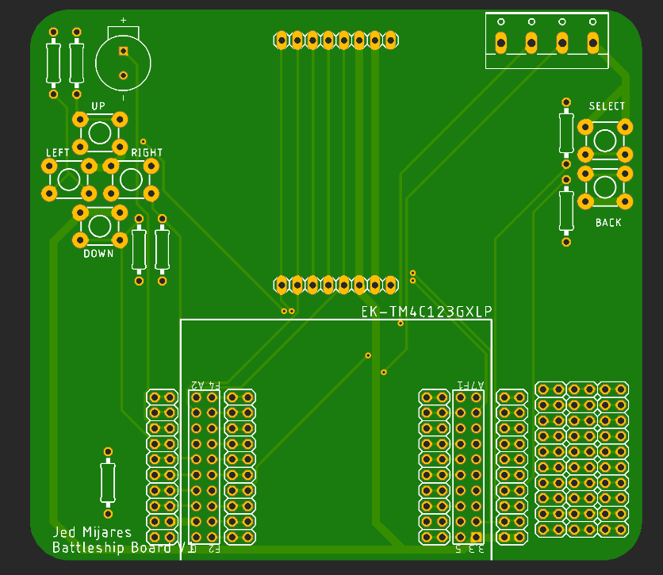
Remaining Work
Implement randomization
Clean up code/formatting
Produce video
Print/assemble PCB
Online scoreboard
UART Multiplayer/computer player
Create frame

Slide 5

Difficulties
Learning how to use GitHub collaboratively
LCD blur prevented us from making a more “actiony” game
Discovered we could only print bitmaps of an even width

